Slide 1
CALIBER 2026 Hackathon Submission Template
Team Group073

Slide 2
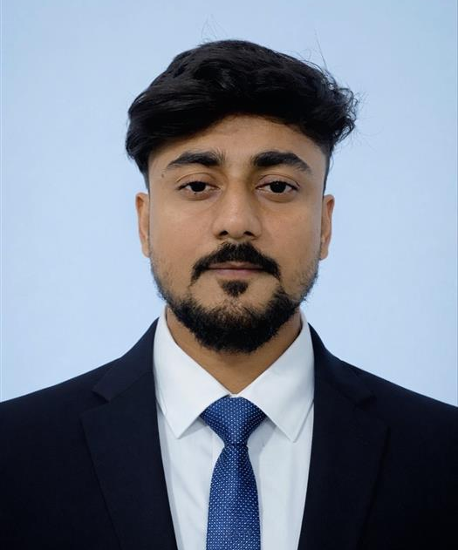
Introduction of the Team with Pictures
Introduction of the Team
Om Shankar Thakur – Lead Developer

Slide 3
Project Overview
EXECUTIVE SUMMARY
MedOrchestrator is an AI-powered clinical decision-support platform that orchestrates multiple specialized agents to analyze patient symptoms, lab results, and medications in parallel producing differential diagnoses, evidence-based treatment recommendations, and drug-safety alerts under clinician supervision.
OBJECTIVE
Build a multi-agent AI system that runs analyses in parallel for speed
Provide ranked differential diagnoses with confidence scores and reasoning
Generate guideline-aligned treatment plans with dosing and monitoring
Flag drug interactions and critical lab values automatically
Surface dissenting opinions when agents disagree for clinical transparency
PROBLEM STATEMENT
Clinicians face information overload when diagnosing complex conditions
Manual correlation of symptoms, lab values, and drug interactions is time-consuming and error-prone
Delayed diagnosis impacts patient outcomes and increases healthcare costs
No integrated system exists to combine multiple clinical data sources intelligently

Slide 4
Technical Architecture

Slide 5
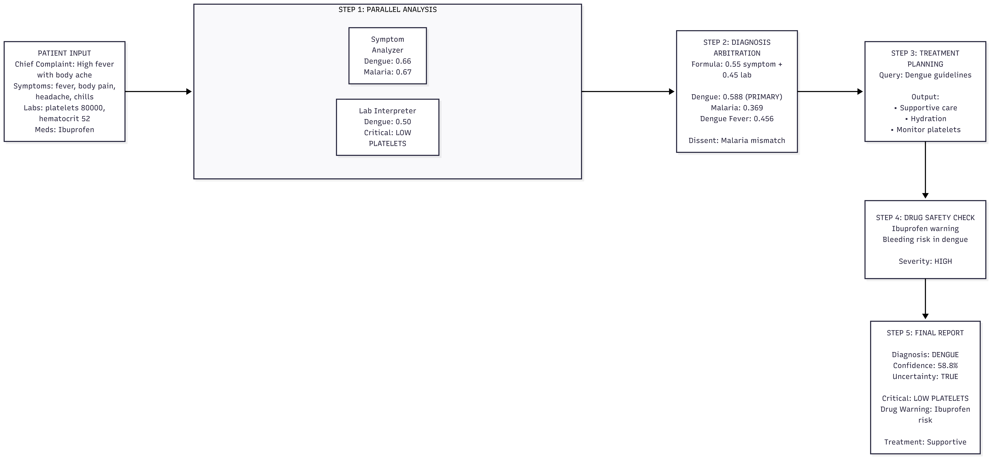
Technical Workflow

Slide 6
Technical Justification
• FastAPI: Async, high-performance API with automatic OpenAPI docs
• Streamlit: Rapid UI development, ideal for clinical data forms
• FAISS: Facebook's vector search, handles millions of embeddings efficiently
• Azure OpenAI: Enterprise-grade LLM with HIPAA compliance capability
• Sentence-Transformers: State-of-the-art embeddings for semantic matching
• ThreadPoolExecutor: Native Python parallelism for concurrent agent execution

Slide 7
Execution Steps
SETUP INSTRUCTIONS
1. Clone the repository:
git clone https://github.com/Om-Shankar-Thakur/clinical-ai-multiagent.git
cd clinical-AI_NW
2. Create virtual environment:
python -m venv venv
venv\Scripts\activate # Windows
3. Install dependencies:
pip install -r requirements.txt
4. Configure environment (.env file)
5. Ingest data (first time only):
python rag/ingest.py
EXECUTION PROCESS
Terminal 1 (Backend):
uvicorn server:app --reload --port 8000
Terminal 2 (Frontend):
streamlit run streamlit_app.py
Access:
• Streamlit UI: http://localhost:8501
• API Docs: http://localhost:8000/docs
TROUBLESHOOTING TIPS
• "Module not found": Run pip install -r requirements.txt
• "FAISS index not found": Run python rag/ingest.py
• "Azure API error": Verify .env file credentials
• "Connection refused": Ensure backend is running before frontend

Slide 8
VM Details & Instructions to execute code (If any)
How to Execute the Code (Steps)
Step 1: Connect via RDP/SSH to VM
Step 2: Navigate to project directory - cd c:\path\to\clinical-AI_NW
Step 3: Activate virtual environment - \venv\Scripts\activate
Step 4: Start FastAPI backend (Terminal 1) - uvicorn server:app --reload --port 8000
Step 5: Start Streamlit frontend (Terminal 2) - streamlit run streamlit_app.py
Step 6: Open browser to http://localhost:8501
Step 7: Enter patient data and click "Analyze Patient"

Slide 9
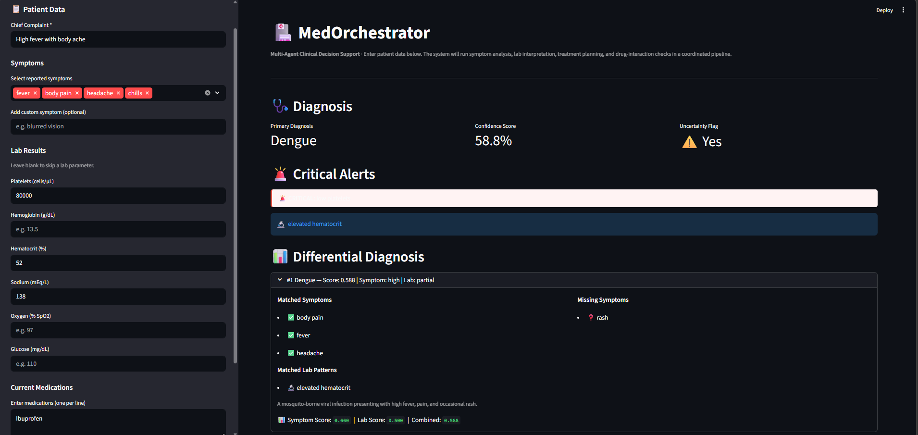
Demo and Results
GitHub Repository URL - https://github.com/Om-Shankar-Thakur/clinical-ai-multiagent
KEY FINDINGS AND RESULTS
Parallel Execution: 2× faster diagnosis via concurrent agent processing
High Accuracy: Dengue correctly identified with 0.588 confidence from
symptoms (fever, body pain, headache, chills) + lab patterns (low platelets)
Critical Alert Detection: Low platelets (<100K) flagged as critical
Drug Safety: Ibuprofen flagged as HIGH SEVERITY risk for dengue
(bleeding risk with thrombocytopenia)
Dissenting Opinions: Malaria ranked #1 by symptoms but #4 by labs —
system surfaced this disagreement for clinician review
Guideline Alignment: Treatment plans generated from retrieved clinical
guideline documents (RAG-based)
SAMPLE OUTPUT
Primary Diagnosis: Dengue
Confidence: 58.8%
Critical Flags: 🚨 Low Platelets
Drug Warning: ⚠️ Ibuprofen bleeding risk (HIGH)
Dissent: Malaria symptom #1 vs lab #4

Slide 10
Additional Details in Brief (Add as much as possible)
USE CASE / IDEA
• Emergency Room triage: Rapid differential diagnosis from intake symptoms
• Outpatient clinics: Decision support for primary care physicians
• Rural healthcare: Expert-level guidance where specialists are unavailable
• Clinical training: Educational tool for medical students
INTRODUCTION TO SOLUTION
MedOrchestrator uses 4 specialized AI agents coordinated by an orchestrator:
1. Symptom Analyzer — semantic search over disease database
2. Lab Interpreter — rule-based critical value detection
3. Treatment Planner — RAG retrieval + LLM guideline formatting
4. Drug Interaction Checker — LLM safety review
TECHNICAL DETAILS — WHY THESE COMPONENTS?
• FAISS over Pinecone: Local execution, no external API costs, fast
• Sentence-BERT (all-MiniLM-L6-v2): 5× faster than BERT, 384-dim efficient
• FastAPI over Flask: Native async, Pydantic validation, auto-docs
• ThreadPoolExecutor over asyncio: Simpler for CPU-bound agent work
• Weighted arbitration (55/45): Symptoms more reliable than partial labs
• Confidence threshold (0.4): Prevents hallucinated plans for uncertain dx
WHAT IT DOES (DETAILED)
Input: Chief complaint, symptoms, lab values, current medications
↓
Step 1: Symptom Analyzer + Lab Interpreter run IN PARALLEL
(ThreadPoolExecutor with 2 workers)
↓
Step 2: Orchestrator ARBITRATES diagnosis
(55% symptom score + 45% lab score weighted merge)
↓
Step 3: Treatment Planner retrieves guidelines via FAISS
LLM formats into structured management options
↓
Step 4: Drug Interaction Checker validates against medications
Flags contraindications with severity levels
↓
Output: JSON report with diagnosis, confidence, treatment plan,
drug warnings, critical flags, dissenting opinions

Slide 11
Future Roadmap and Next Steps
Product Roadmap:
Q3 2026
Radiology Image Agent (X-ray / CT analysis)
Voice-based symptom input
Expand disease coverage
Q4 2026
FHIR / HL7 healthcare integration
EHR system connectivity
Audit logging & HIPAA compliance strengthening
Q1 2027
Multi-language support
Mobile application launch
Offline capability
FDA/CE regulatory pathway initiation
Planned Enhancements:
Radiology AI Agent for imaging insights
Patient History Module (longitudinal data analysis)
Confidence Calibration using real-world clinical data
Explainability Dashboard for transparent decision-making
Multi-modal Input (voice + structured data)
Next Steps (Post-Hackathon)
Deploy on Azure App Service Pilot with Cognizant healthcare clients
Expand to 200+ diseases Integrate ICD-10 coding for billing
Conduct clinical validation studies
Initiate FDA/CE regulatory process

Slide 12
Thank You

